Slide 1





Understanding Chlorine Salt Spectra Through Computational Methods with Implications for Martian Geochemistry
Rachel Huchmala, Northern Arizona University
Mentor: Dr. Jennifer Hanley, Lowell Observatory

Slide 2
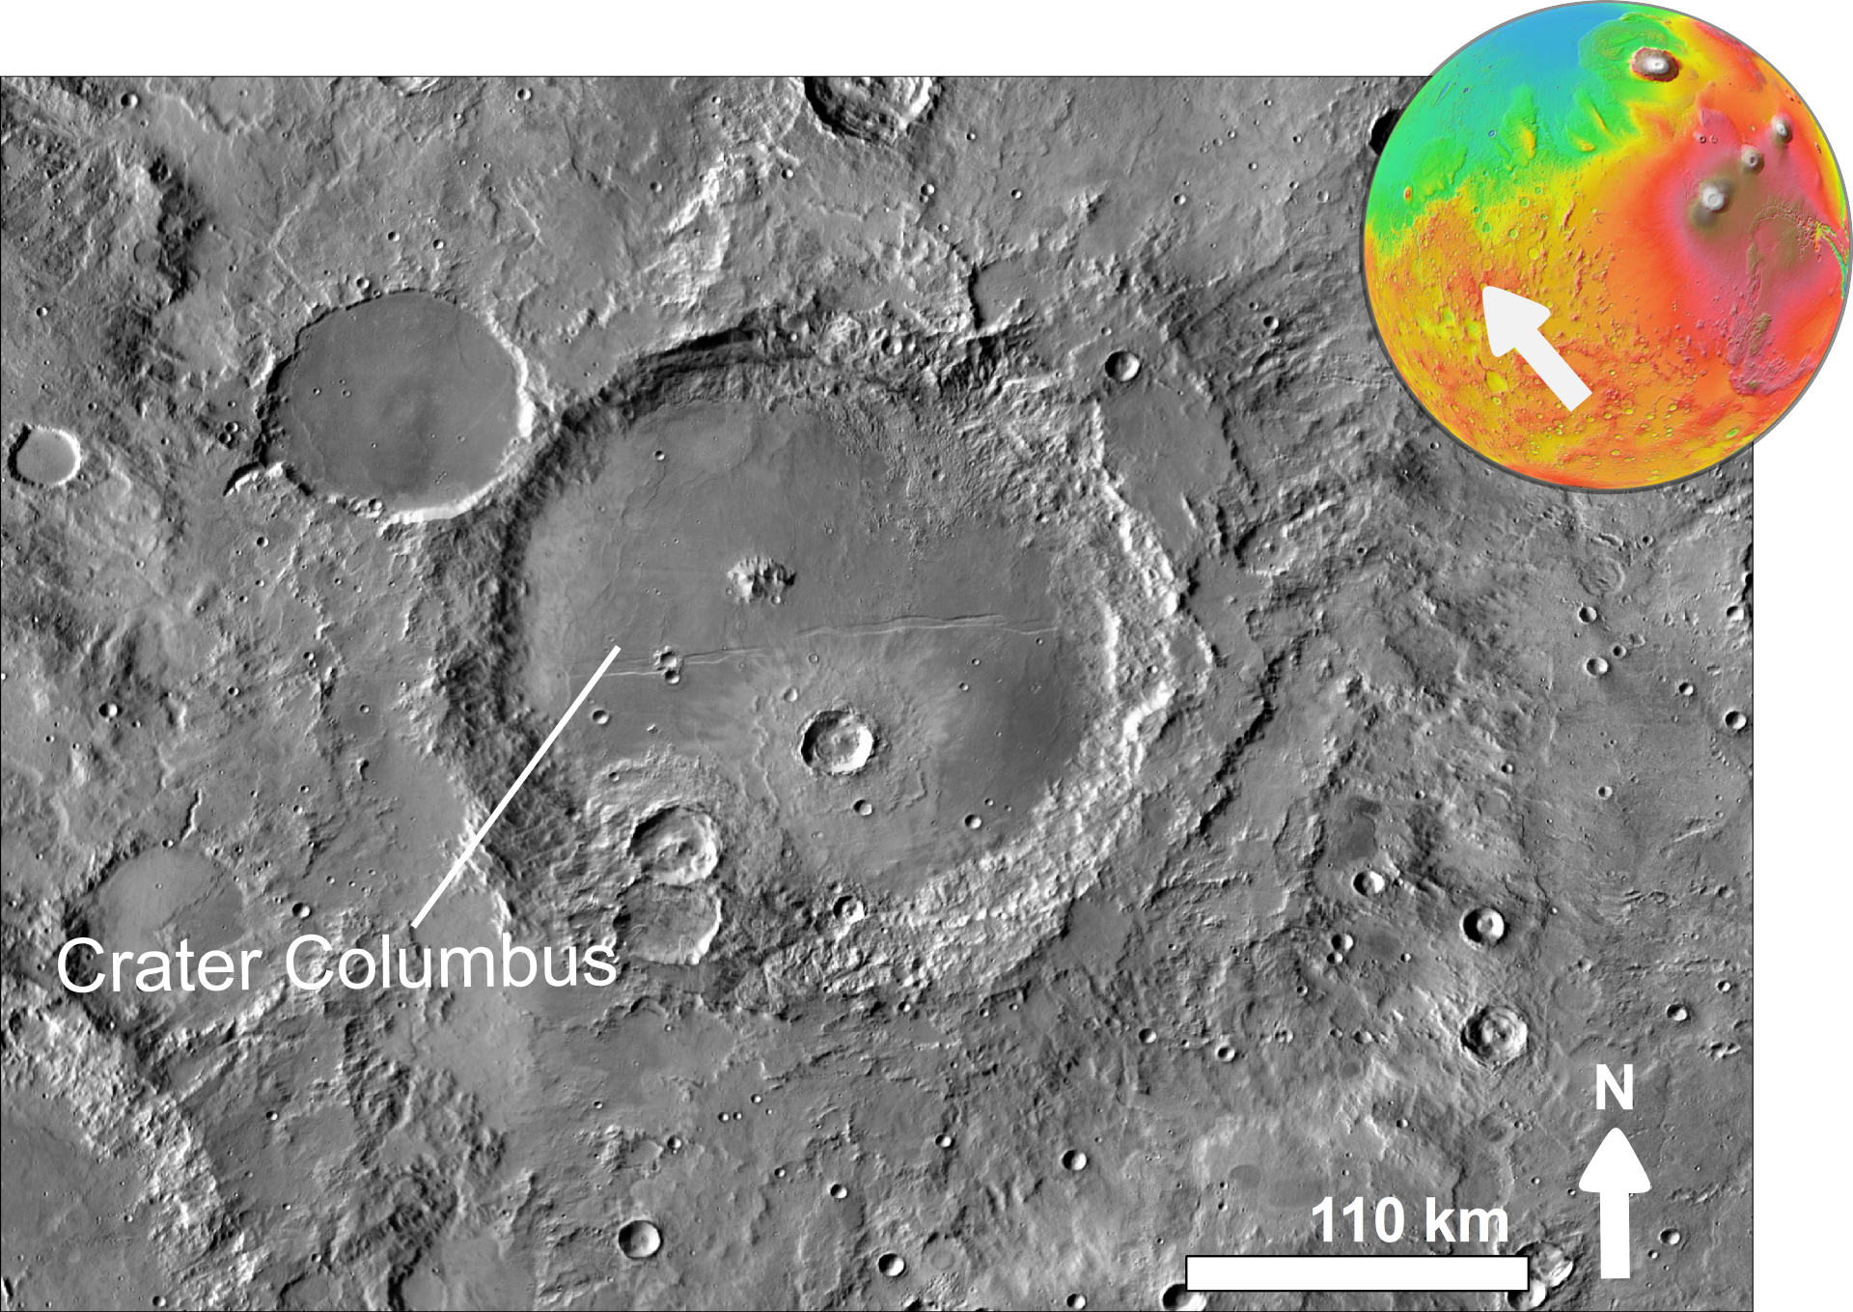
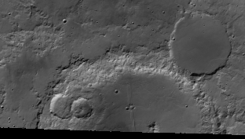
Motivation: Columbus Crater
Continued exploration of Mars has led to a need to characterize the toxicity and habitability of the planet.
We have focused on Columbus Crater which contains a “Bathtub Ring” of hydrated minerals.
By mapping the distribution of these minerals, we can determine potentially toxic areas.
“Bathtub Ring”
Image complied from: NASA THEMIS and MOLA data
Image from: MEx HRSC (H0538_0000_DA4) Credit: ESA/DLR/FU Berlin

Slide 3
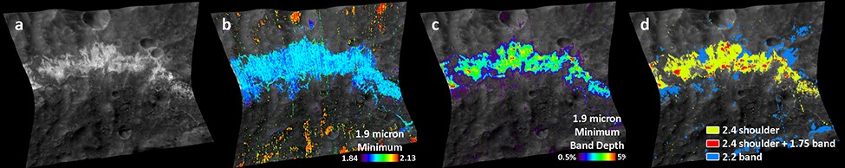
Data: Compact Reconnaissance Imaging Spectrometer
The Compact Reconnaissance Imaging Spectrometer for Mars (CRISM) collects visible and infrared spectra.
For each pixel of a CRISM image, there is a corresponding spectra in the wavelength range from 0.362-3.92 microns.
Using the near-infrared spectra, we can start to distinguish minerals in the salt ring of Columbus Crater.
Image From: Hanley et al, LPSC (2017)
Image from: MEx HRSC (H0538_0000_DA4) Credit: ESA/DLR/FU Berlin
Image from: MEx HRSC (H0538_0000_DA4) Credit: ESA/DLR/FU Berlin

Slide 4
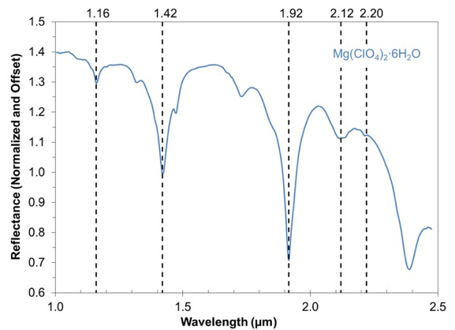
Making the Distinction
Laboratory spectra from Hanley et al. [2015] show bands for magnesium perchlorate hexahydrate at 2.12 µm and 2.20 µm that are unique, but a result of some unknown cause.
Could finding possible causes of these absorptions be the key to making the distinction?
Image from: Hanley et al., JGR (2015)

Slide 5
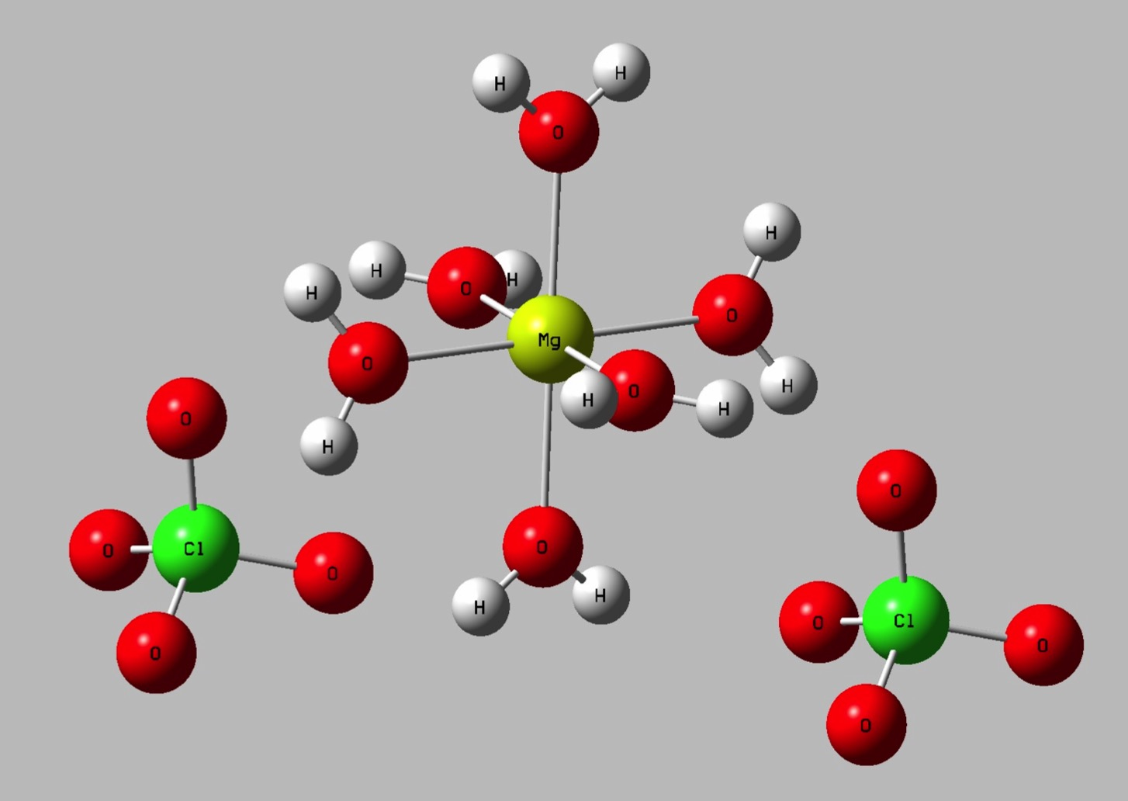
Spectral Properties
Bischofite (MgCl₂⋅6H₂O)
Hexahydrite (MgSO₄⋅6H₂O)
Magnesium perchlorate hexahydrate
(Mg(ClO₄)₂⋅6H₂O)
Due to the structural similarities, the infrared spectra are very similar.
Making this determination is crucial, as perchlorates can be toxic, especially to humans, and cause a much lower freezing point depression of water.

Slide 6
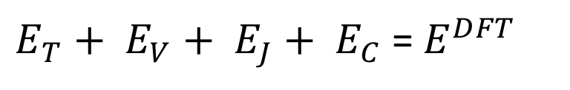
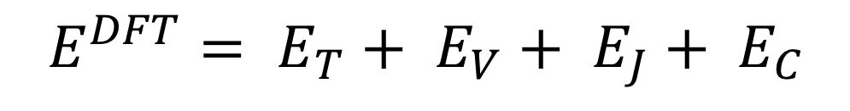
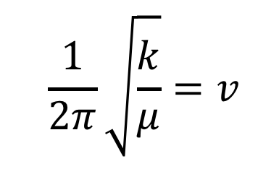
Methods: Density Functional Theory
The electronic wave function is constructed with the 6-31G basis set, which represents core atomic orbitals by one set of Gaussian functions and valence atomic orbitals by two sets of Gaussian functions.
We use cam-B3LYP, a hybrid functional of Hartree-Fock exchange and DFT correlation exchange with a split-valence basis set, 6-31G.
$$\frac{1}{2π}\sqrt{\frac{k}{μ}}=v$$
Take the second derivative to calculate k
Predicted Vibrational Frequencies!
$E_{T}+ E_{V}+ E_{J}+ E_{C}$ = $E^{DFT}$
Kinetic
Coulomb
Exchange/Correlation
Electron-nuclear Potential
$$E^{DFT}= E_{T}+ E_{V}+ E_{J}+ E_{C}$$
$$E^{DFT}= E_{T}+ E_{V}+ E_{J}+ E_{C}$$

Slide 7
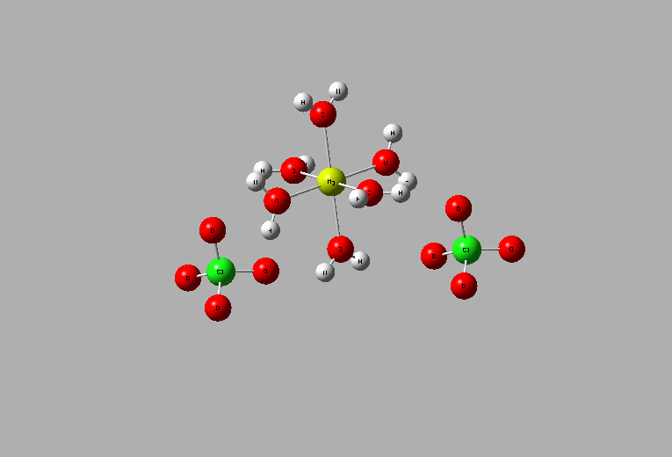
Analysis
Fundamental Vibrational Mode | Stretch Type | Computational Frequency (µm)
𝛎_{asy(H2O)} | Asymmetric Water Stretch | 2.51
𝛎_{sys(H2O)} | Symmetric Water Stretch | 2.58
𝛎_{syb(H2O)} | Symmetric Water Bend | 5.94
𝛎_{asy(ClO4)} | Asymmetric Perchlorate Stretch | 7.42
𝛎_{sys(ClO4)} | Symmetric Perchlorate Stretch | 8.99
𝛎_{asb(H2O)} | Asymmetric Water Bend | 17.50
Magnesium perchlorate
hexahydrate
(MgClO₄ ⋅ 6H₂O)

Slide 8
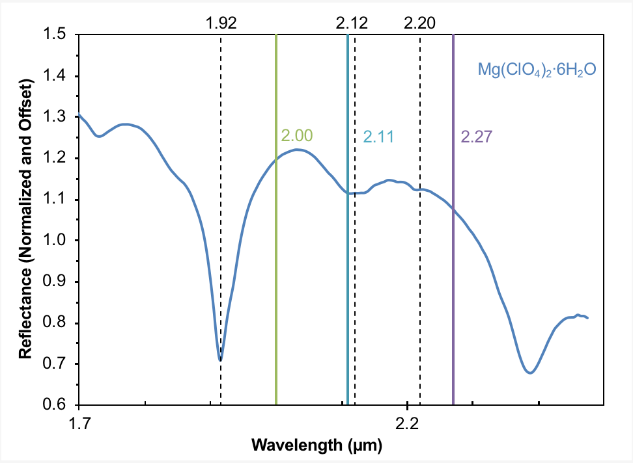
Computing Overtones and/or Combinations
Overtone: Multiples of a fundamental vibrational mode
Combination: Sum of fundamental vibrational modes and/or overtone bands
Using the fundamental modes that were calculated, possibilities for the 2.12 µm and 2.20 µm bands are as follows:
𝛎 _{sys(H2O)} + 𝛎 _{sys(ClO4)} = 2.00 µm
𝛎_{asy(ClO4)} +2(𝛎_{sys (ClO4)})+ 𝛎_{asb(H2O)} = 2.11 µm
2(𝛎_{asy(ClO4)})+ 𝛎_{sys(ClO4)}+ 𝛎 _{asb(H2O)} = 2.27 µm
Image from: Hanley et al., JGR (2015)
Possible combinations are:
𝛎 _{symmetric (H2O)} + 𝛎 _{symmetric (ClO4)} = 2.00 µm
𝛎 _{asymmetric (ClO4)} +2(𝛎 _{symmetric (ClO4)})+ 𝛎 _{asymmetric bend(H2O)} = 2.11 µm
2(𝛎 _{asymmetric (ClO4)})+ 𝛎 _{symmetric (ClO4)}+ 𝛎 _{asymmetric bend(H2O)} = 2.27 µm

Slide 9
Conclusions
Our method is working!
Identifying the fundamental modes of magnesium perchlorate hexahydrate, has provided us with a basis for calculating overtones.
Results from these computations have enabled us to assign fundamental vibrations of commonly found stable salts on Mars.
Image from: Hanley et al., JGR (2015)
Possible combinations are:
𝛎 _{symmetric (H2O)} + 𝛎 _{symmetric (ClO4)} = 2.00 µm
𝛎 _{asymmetric (ClO4)} +2(𝛎 _{symmetric (ClO4)})+ 𝛎 _{asymmetric bend(H2O)} = 2.11 µm
2(𝛎 _{asymmetric (ClO4)})+ 𝛎 _{symmetric (ClO4)}+ 𝛎 _{asymmetric bend(H2O)} = 2.27 µm

Slide 10
Acknowledgments
I’d like to thank…
The NASA/NAU Space Grant
Dr. Jennifer Hanley, my project mentor
Dr. Gerrick Lindberg, my computational research mentor
My officemates for dealing with me yelling at my computer.

Slide 11
Back-up Slides

Slide 12

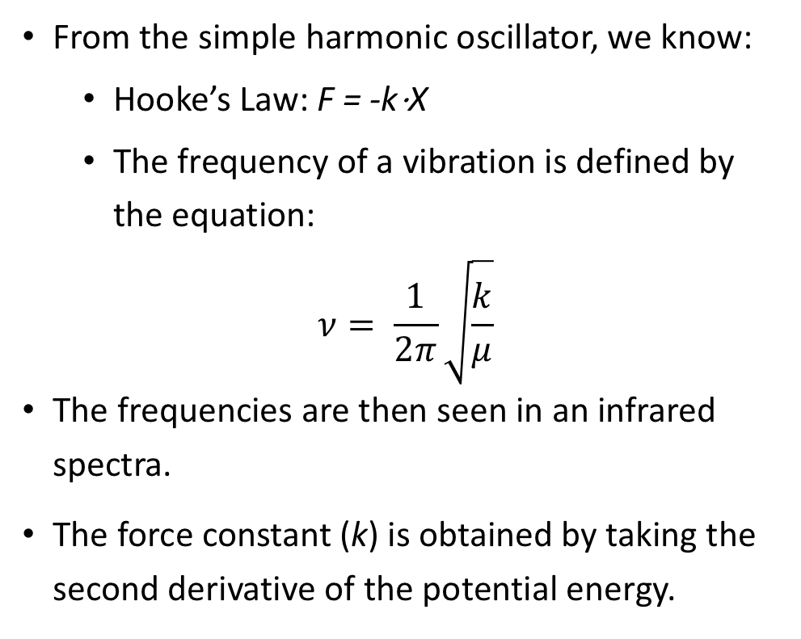
Vibrational Spectra
From the simple harmonic oscillator, we know:
Hooke’s Law: F = -k⋅X
The frequency of a vibration is defined by the equation:
$$ν= \frac{1}{2π}\sqrt{\frac{k}{μ}}$$
The frequencies are then seen in an infrared spectra.
The force constant (k) is obtained by taking the second derivative of the potential energy.

Slide 13
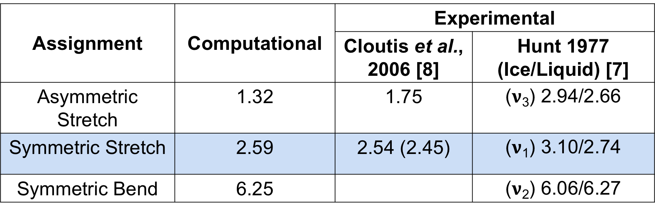
Water Fundamentals
Assignment | Computational | Experimental
 |  | Hanley et al., 2015 [4] | Bishop et al., 2014 [6] | Hunt 1977 (Ice/Liquid) [7]
Asymmetric Stretch | 2.51 | 2.76 | 2.77 | (𝛎₃) 2.94/2.66
Symmetric Stretch | 2.58 | 2.76 | 2.77 | (𝛎₁) 3.10/2.74
Symmetric Bend | 5.94 | 6.04 | 6.06 | (𝛎₂) 6.06/6.27
Assignment | Computational | Experimental
 |  | Hanley et al., 2015 [4] | Bishop et al., 2014 [6] | Hunt 1977 (Ice/Liquid) [7]
Asymmetric Stretch | 2.51 | 2.76 | 2.77 | (𝛎₃) 2.94/2.66
Symmetric Stretch | 2.58 | 2.76 | 2.77 | (𝛎₁) 3.10/2.74
Symmetric Bend | 5.94 | 6.04 | 6.06 | (𝛎₂) 6.06/6.27
Assignment | Computational | Experimental
 |  | Hanley et al., 2015 [4] | Bishop et al., 2014 [6] | Hunt 1977 (Ice/Liquid) [7]
Asymmetric Stretch | 2.51 | 2.76 | 2.77 | (𝛎₃) 2.94/2.66
Symmetric Stretch | 2.58 | 2.76 | 2.77 | (𝛎₁) 3.10/2.74
Symmetric Bend | 5.94 | 6.04 | 6.06 | (𝛎₂) 6.06/6.27
Bischofite (MgCl₂ ⋅ 6H₂O)
Assignment | Computational | Experimental
 |  | Hanley et al., 2014 [5] | Hunt 1977 (Ice/Liquid) [7]
Asymmetric Stretch | 2.37 | 2.42 | (𝛎₃) 2.94/2.66
Symmetric Stretch | 2.55 | 2.82 | (𝛎₁) 3.10/2.74
Symmetric Bend | 6.22 | 6.11 | (𝛎₂) 6.06/6.27

